Slide 1


Exposing Services with
Azure API Management
Callon Campbell
Solutions Architect | Developer | Microsoft MVP
Cloud Mavericks Inc.
Email: | Callon@CloudMavericks.ca
Blog: | TheFlyingMaverick.com
Twitter: | @Flying_Maverick
GitHub: | GitHub.com/CallonCampbell

Slide 2
About me
Solution Architect | Developer
Microsoft MVP in Azure
20 years enterprise development with Microsoft technologies – .NET, Azure, Web, Desktop, SQL, and Mobile
Blogging at https://theflyingmaverick.com
Speaker at community events and meetups
Co-creator of ReflectInsight, live .NET log viewer

Slide 3
Agenda
Why API Management?
Azure API Management Overview
Demos
Q&A

Slide 4
What’s in common?
Internet
of
Things
Machine
Learning
Mobile
APIs
Software
as a
Service
Cloud
Computing
Blockchain
Notes:
Looking at the applications and services we see today, there is a common core that is at the heart of almost every application.

Slide 5
World of APIs
Every app requires APIs
Internal and External
Everyone wants to integrate
Integration is a must
Mobility
IoT
Customer Experience
Notes:
APIs are also central to mobility and IoT, whether it’s your API or a 3rd party service.
Customer experience is also key…how can you drive developer adoption, who is using our apis, how are they being used, and how are they functioning in production.

Slide 6
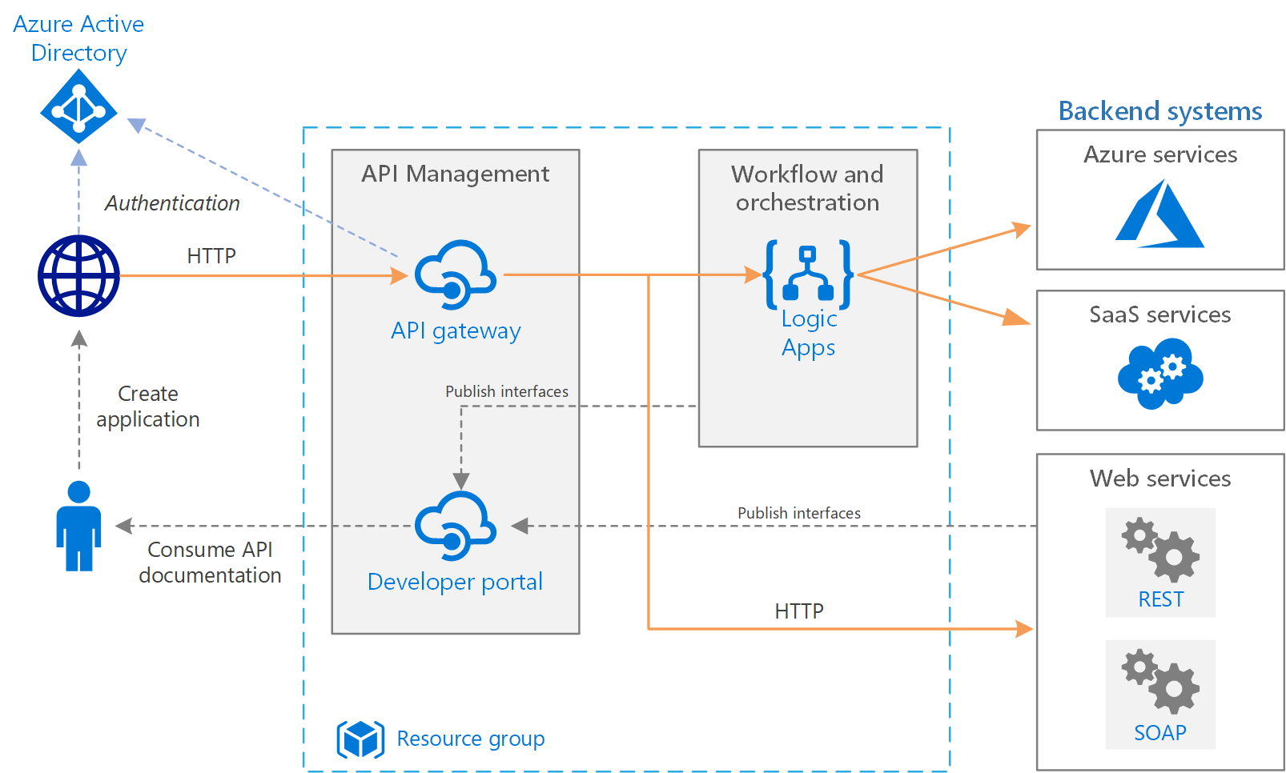
Basic Enterprise Integration
Architecture reference:
https://docs.microsoft.com/en-us/azure/architecture/reference-architectures/enterprise-integration/basic-enterprise-integration
Notes:
Just wanted to set context for the rest of the presentation in where an API gateway fits in.

Slide 7
What is Azure API Management?
API Management is a managed service for publishing, securing, analyzing and managing APIs
Common use cases:
Enterprise API catalog
Single place for discovery and onboard your APIs
Often used with Azure Service Bus, Logic Apps, Event Grid and Azure Functions
Notes:
Azure API Management is a managed service for publishing, securing, analyzing and managing your APIs.
Two common use cases are an enterprise API catalog and central place for discovery to onboard your APIs.

Slide 8
Why Azure API Management
Consolidate your APIs
Centralize authentication
Monitor usage & performance
Unified paths
Throttling & caching
Input and output transformations
Documentation and API testing
API governance, insights and analytics
Notes:
Azure API Management abstracts, protects and optimizes your APIs.
Cloud hosted, turnkey, and fully managed.
Works with APIs running in the cloud or on-prem.
Publish, secure and transform your APIs.
Promotes and supports app developer engagement.
Provides API governance, insights, and analytics.

Slide 9
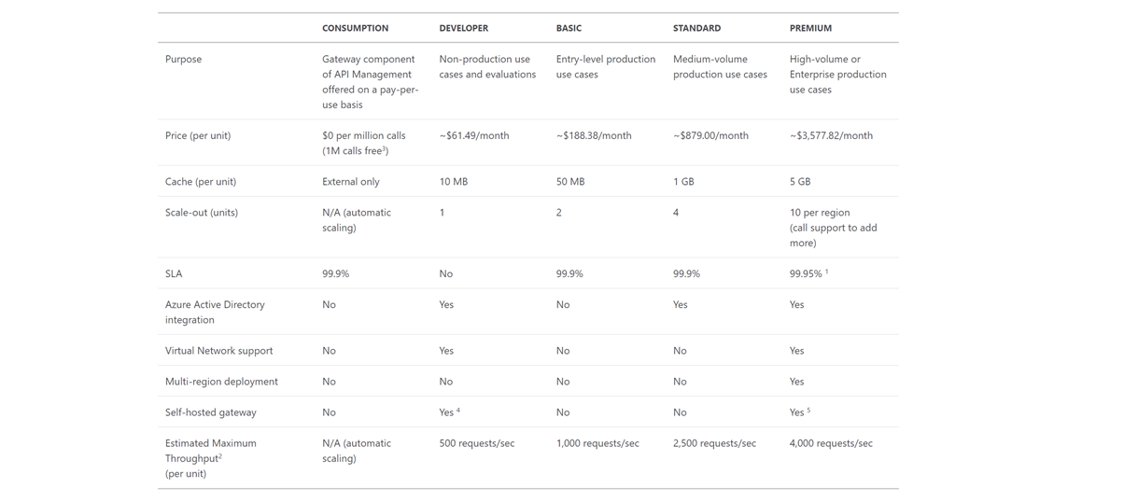
Available tiers
Consumption
Developer
Basic
Standard
Premium
Notes:
Self-hosted gateway is currently in preview and only available in the developer and premium tiers.
No developer portal for the consumption tier, but you can use the self-hosted developer portal.

Slide 10







API Management
1st and 3rd party apps
Abstract
Secure & protect
Manage lifecycle
Monitor & measure
Onboard developers
Monetize
Discover
Learn
Get access
Try
Get help
SDKs and samples
Consume
Mediate
Publish
Developer portal
Gateway
Azure portal
API publishers
App developers
APIs hosted on and outside of Azure
Notes:
Typical API scenario

Slide 11



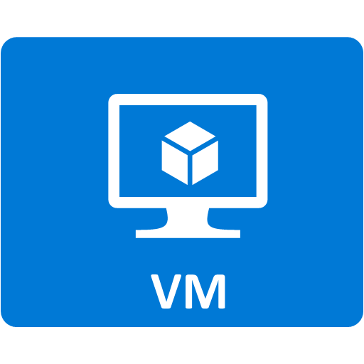

Façade and front door
Developer portal
Consume
App developers
Gateway
Mediate
1st and 3rd party apps
contosoapi-foo.azurewebsites.com
Azure portal
Publish
APIs on Azure and outside
API managers and developers

Slide 12
Core Components
Developer Portal
Documentation and test environment
Self-service access to APIs
Gateway
Proxy API (requests and responses)
Azure Portal
API Lifecycle Management
Manage access and policies
Transform/Orchestrate requests and responses
Policies (throttling, security, etc.)
Consumption analytics
Logging and Monitoring
Authentication/Authorization
Products (bundles of APIs)
Ability to subscribe and get access keys
Developer testing and debugging
Caching
API Definition
Notes:
Azure Portal
Manage
- creation, versioning, revisions, retirement
Gateway
-
Developer Portal
-

Slide 13
Provide a first-rate developer experience Developer Portal
Self-service API key management
Auto-generated API catalog, documentation, and code samples
OAuth-enabled API console for exploring APIs without writing a line of code
Sign in using popular Internet identity providers and Azure Active Directory

Slide 14
Protect and optimize your APIs Gateway
Simplify and optimize requests and responses with transformation policies
Secure APIs with key, JSON Web Token (JWT) validation, and IP filtering
Protect your APIs from overload and overuse with quotas and rate limits
Use response caching for improved latency and scale

Slide 15
Manage all of your APIs in one place Azure Portal
Expose all APIs behind a single static IP and domain
Get near real-time usage, performance and health analytics
Automate management and integrate using REST API, PowerShell, and Git
Provision API Management and scale it on demand in one or more geographical regions

Slide 16
Connect to back-end services anywhere Azure Portal
Client certificate authentication
Azure virtual networks
Azure ExpressRoute

Slide 17
Policies

Slide 18
There is a policy for that
Encapsulate common API management functions
Access control, Protection, Transformation, Caching, …
Mutate request context or change API behavior
Add a header or throttle for example
Set in the inbound and outbound directions
Applied at a variety of scopes or on error
Scope determines which APIs are affected
Can define custom scopes in addition to four available b default
Composed into a pipeline from effective scopes
Degree of control over inheritance of scopes, i.e. <base/> element
Don’t delete <base/> inadvertently
http://aka.ms/apimpolicyexamples
Notes:
In Azure API Management (APIM), policies are a powerful capability of the system that allow the publisher to change the behavior of the API through configuration.
Policies are a collection of Statements that are executed sequentially on the request or response of an API.
Policies are applied inside the gateway which sits between the API consumer and the managed API. The gateway receives all requests and usually forwards them unaltered to the underlying API. However a policy can apply changes to both the inbound request and outbound response.

Slide 19
Some policies out of the box
Rate Limiting
Quota enforcing
Check HTTP headers
Restrict caller IP
Validate JWT tokens
Retrying (QoS)
Masking URLs
Defining cache policies
Throttling
CORS
URL Rewriting
XML < > JSON

Slide 20
Policy reference index
Access restriction policies
Check HTTP header - Enforces existence and/or value of a HTTP Header.
Limit call rate by subscription - Prevents API usage spikes by limiting call rate, on a per subscription basis.
Limit call rate by key - Prevents API usage spikes by limiting call rate, on a per key basis.
Restrict caller IPs - Filters (allows/denies) calls from specific IP addresses and/or address ranges.
Set usage quota by subscription - Allows you to enforce a renewable or lifetime call volume and/or bandwidth quota, on a per subscription basis.
Set usage quota by key - Allows you to enforce a renewable or lifetime call volume and/or bandwidth quota, on a per key basis.
Validate JWT - Enforces existence and validity of a JWT extracted from either a specified HTTP Header or a specified query parameter.
Advanced policies
Control flow - Conditionally applies policy statements based on the evaluation of Boolean expressions.
Forward request - Forwards the request to the backend service.
Limit concurrency - Prevents enclosed policies from executing by more than the specified number of requests at a time.
Log to Event Hub - Sends messages in the specified format to a message target defined by a Logger entity.
Mock response - Aborts pipeline execution and returns a mocked response directly to the caller.
Retry - Retries execution of the enclosed policy statements, if and until the condition is met. Execution will repeat at the specified time intervals and up to the specified retry count.
Return response - Aborts pipeline execution and returns the specified response directly to the caller.
Send one way request - Sends a request to the specified URL without waiting for a response.
Send request - Sends a request to the specified URL.
Set HTTP proxy - Allows you to route forwarded requests via an HTTP proxy.
Set variable - Persist a value in a named context variable for later access.
Set request method - Allows you to change the HTTP method for a request.
Set status code - Changes the HTTP status code to the specified value.
Trace - Adds custom traces into the API Inspector output, Application Insights telemetries, and Diagnostic Logs.
Wait - Waits for enclosed Send request, Get value from cache, or Control flow policies to complete before proceeding.
Authentication policies
Authenticate with Basic - Authenticate with a backend service using Basic authentication.
Authenticate with client certificate - Authenticate with a backend service using client certificates.
Authenticate with managed identity - Authenticate with a backend service using a managed identity.
Caching policies
Get from cache - Perform cache look up and return a valid cached response when available.
Store to cache - Caches response according to the specified cache control configuration.
Get value from cache - Retrieve a cached item by key.
Store value in cache - Store an item in the cache by key.
Remove value from cache - Remove an item in the cache by key.
Cross domain policies
Allow cross-domain calls - Makes the API accessible from Adobe Flash and Microsoft Silverlight browser-based clients.
CORS - Adds cross-origin resource sharing (CORS) support to an operation or an API to allow cross-domain calls from browser-based clients.
JSONP - Adds JSON with padding (JSONP) support to an operation or an API to allow cross-domain calls from JavaScript browser-based clients.
Transformation policies
Convert JSON to XML - Converts request or response body from JSON to XML.
Convert XML to JSON - Converts request or response body from XML to JSON.
Find and replace string in body - Finds a request or response substring and replaces it with a different substring.
Mask URLs in content - Re-writes (masks) links in the response body so that they point to the equivalent link via the gateway.
Set backend service - Changes the backend service for an incoming request.
Set body - Sets the message body for incoming and outgoing requests.
Set HTTP header - Assigns a value to an existing response and/or request header or adds a new response and/or request header.
Set query string parameter - Adds, replaces value of, or deletes request query string parameter.
Rewrite URL - Converts a request URL from its public form to the form expected by the web service.
Transform XML using an XSLT - Applies an XSL transformation to XML in the request or response body.
Notes:
https://docs.microsoft.com/en-us/azure/api-management/api-management-policies

Slide 21
Policy scopes
GET /foo/bar HTTP/1.1
Host: api.constoso.com
Key: 0123456789
global
CORS
LOG
0123456789
product
from caller
RATE
QUOTA
inbound
to backend
/foo
api
JWT
/bar
operation
CACHE
URL
BODY
to caller
from backend
outbound

Slide 22
Security
VNETs
OAuth 2.0
Open ID
Azure AD

Slide 23
Versioning and Revisions

Slide 24
API Versioning & Revisions
No one true way
Version or not?
Semantic versioning?
What is a breaking change?
Where to place version information?
Path? Query? Header? Media type?
How to identify version?
Number? Date? Name?
Approach
Versioning is an opt-in
Natively understand versions at the system level
Offer versioning scheme options
Inform developers about the changes
Control when the changes get adopted
Revisions
Providers choose when to deploy
Versions
Consumers choose when to adopt

Slide 25
New Consumption Tier
Unlike other Azure API Management tiers, the Consumption Tier:
Exposes serverless properties
Runs on shared infrastructure
Scale down to zero in times of no traffic
Billed per execution
Notes:
See announcement

Slide 26
API Management – Consumption Tier
API Management layer for microservice-based architectures
Serverless properties:
Instant provisioning
Automatic scaling – out and back to zero
Built-in high availability
Per action pricing
Curated feature set:
No developer portal
Bring your own response cache
Usage limits

Slide 27
Consumption tier is well suited for:
Applications implemented with serverless compute, such as Functions, or other serverless services (for example, Storage Account or Event Grid)
Applications with microservices-based architectures such as Kubernetes
Applications with highly spikey traffic
Applications in evaluation or test environments

Slide 28
Basic Enterprise Integration
Architecture reference:
https://docs.microsoft.com/en-us/azure/architecture/reference-architectures/enterprise-integration/basic-enterprise-integration
Notes:
This reference architecture uses Azure Integration Services to orchestrate calls to enterprise backend systems. The backend systems may include software as a service (SaaS) systems, Azure services, and existing web services in your enterprise.

Slide 29
Demos
http://aka.ms/apimlove
Start coding

Slide 30
Demo notes
ASP.NET Web API
Import using Open API Specification
Policies – throttling, transform
Testing
Versioning and Revisions
Developer Portal – docs, subscription, testing

Slide 31
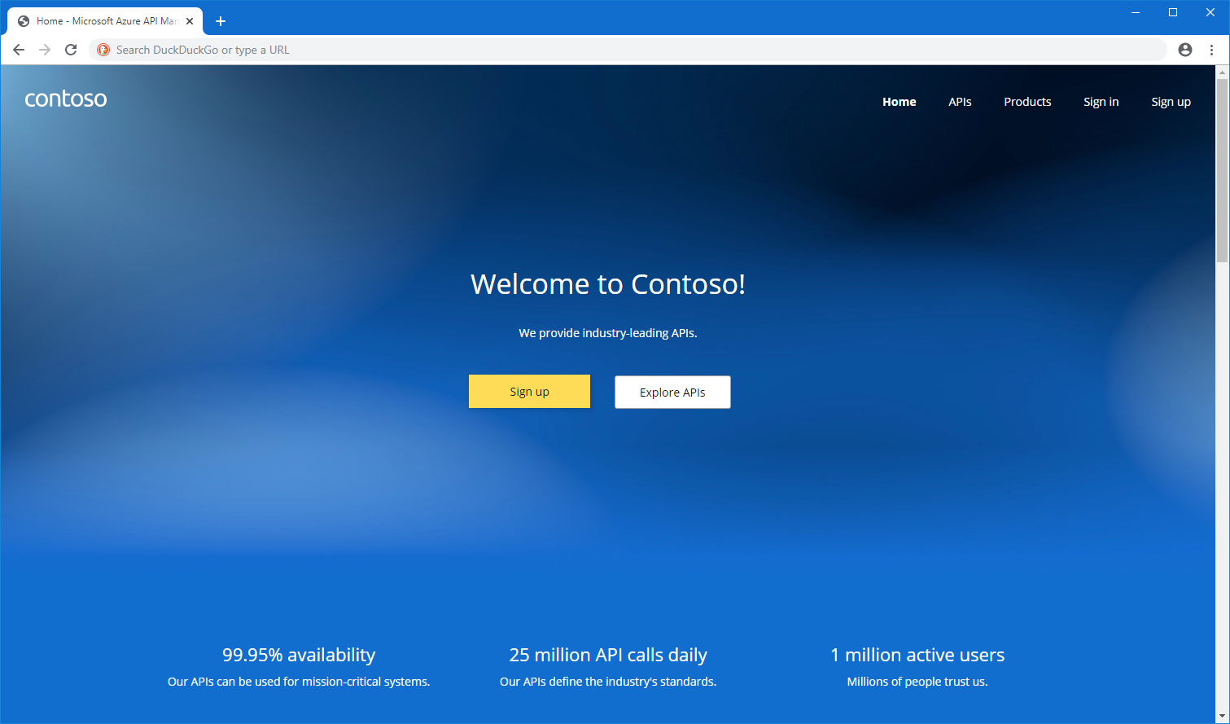
Developer Portal
Auto-generated API catalog, documentation, and code samples
Choose between managed instance or self-hosted
Available in the Premium, Standard, Basic and Developer tiers of API Management.
Notes:
https://github.com/Azure/api-management-developer-portal
https://docs.microsoft.com/en-us/azure/api-management/api-management-howto-developer-portal

Slide 32
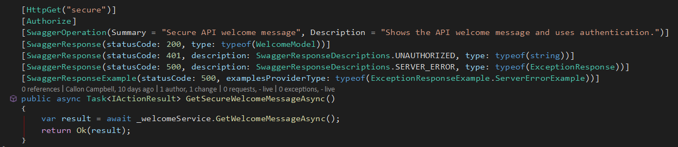
Developer documentation with Swagger
Install the following NuGet Packages into your ASP.NET Core:
Swashbuckle.AspNetCore – v5
Swashbuckle.AspNetCore.Annotations – v5
Swashbuckle.AspNetCore.Newtonsoft – v5
Then decorate your method as shown here…

Slide 33
In closing…
Azure API Management offers the following benefits
Easily create an API façade for the existing backend services
Quickly add new capabilities to the APIs, such as response caching and cross domain access
Package and publish APIs to developers and partners
Reliably protect published APIs from misuse and abuse
Engage developers with dynamically generated, interactive API documentation, samples, forum, and blog
Gain business and operational insights from analytics reports

Slide 34
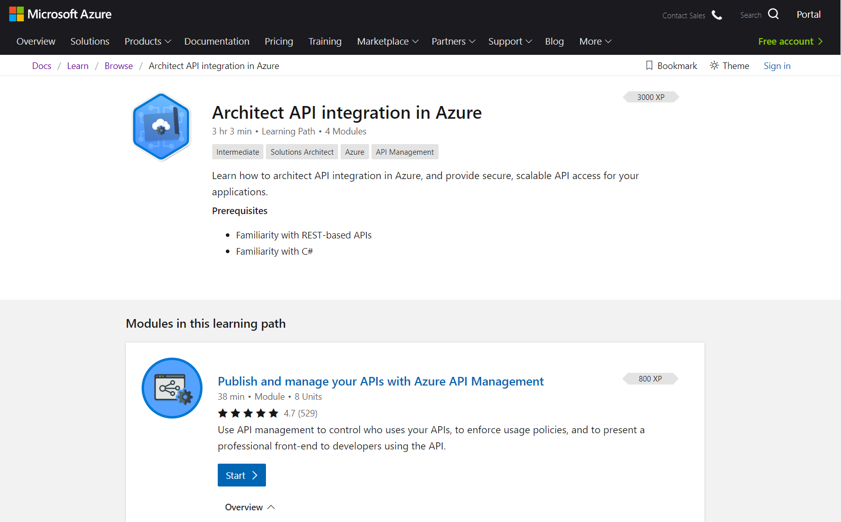
Microsoft Learn
Complete interactive learning exercises, watch videos, and practice and apply your new skills.
https://bit.ly/2VxJCew
Notes:
If you want to learn more about Azure API Management, there is an excellent learning path on Microsoft Learn about how to Architect API integrations in Azure.
Cost is free and a sandbox will automatically provisioned for your hands-on learning.

Slide 35

Download e-book
While there is no “one-size-fits-all” approach to API design, there is a set of common patterns, techniques, and tips we can suggest. This resource offers a potential starting point when thinking about the design for your APIs.
https://aka.ms/api-design-ebook

Slide 36
Resources
Get Certified
Session Resources
All in one resource: http://aka.ms/apimlove
Overview: https://azure.microsoft.com/en-us/services/api-management/
Docs: https://docs.microsoft.com/en-us/azure/api-management/
Article: Expose APIs with peace of mind when using Azure API Management
Session Materials on GitHub
https://github.com/calloncampbell/Azure-API-Management-Demo/
Notes:
http://aka.ms/apimlove

Slide 37

Thank you!
Callon@CloudMavericks.ca
TheFlyingMaverick.com
@Flying_Maverick

Slide 38
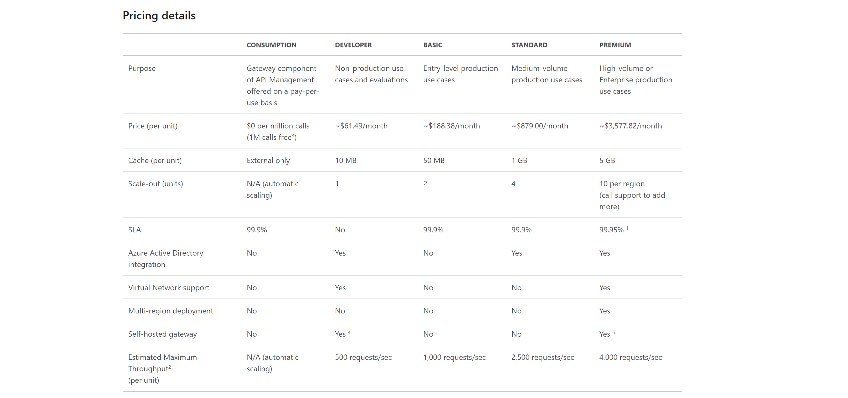
Pricing
Notes:
¹ Requires deployment of at least one unit in two or more regions. ² Actual throughput is affected by many factors including the number and rate of concurrent client connections, the kind and number of configured policies, payload sizes and backend API performance. The numbers presented in the table were obtained by testing with 1000 concurrent persistent client secure HTTP connections, minimal payload sizes, no policies configured, and a low latency backend API.
Prices are in Canadian Dollar and based per month.
The developer tier is for API Management trial, development, and functional test. Customers should not use this tier for production.
There is no on-premises deployment option available at this time. However, you can certainly use Azure-based API management with on-premises systems and data.

Slide 39
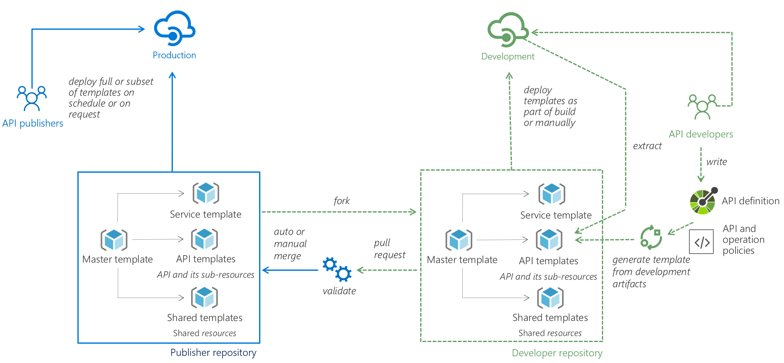
CD/CD with API Management
Notes:
DevOps Resource Kit:
https://github.com/Azure/azure-api-management-devops-resource-kit

